Slide 1
GUI PRESENTATION
Presented By : Kailas Landge

Slide 2
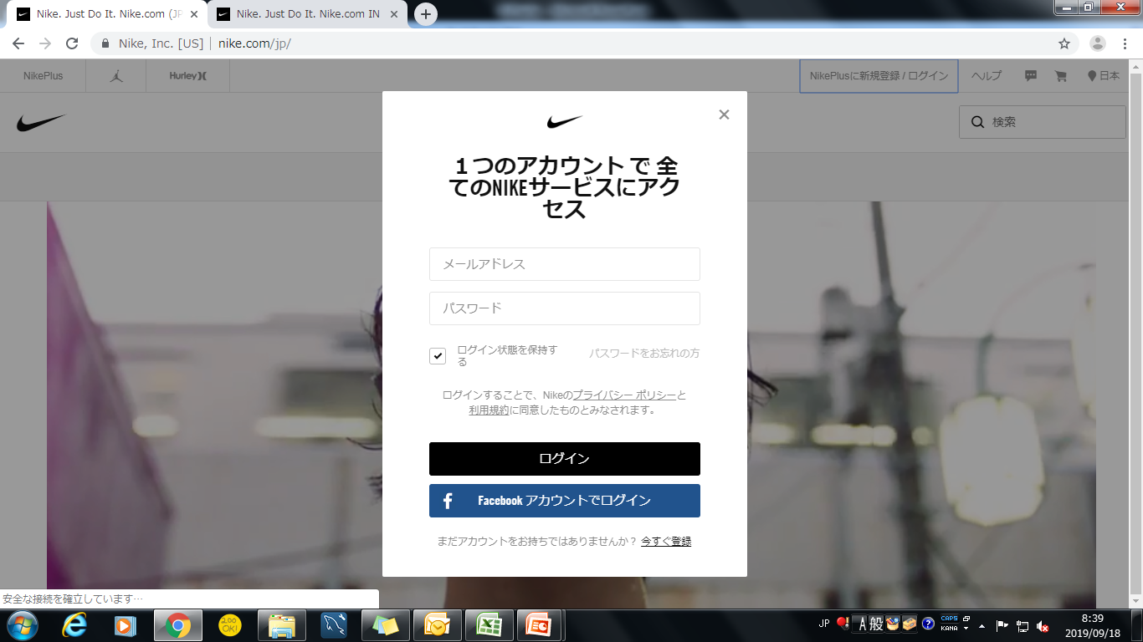
sign in page
10
1
2
11
3
4
5
6
7
9
8

Slide 3
The logo of website shown in center of the page and panel
The block is in center of the page and in background is playing video.
Email address text field simple with place holder Email address
Password text field also simple with place holder Password
One checkbox is there to keep me login so do not login again and again
Small link is given forgot password and it is 50% blur
Login button has large in size and black in background color
One link is given if your account is not present then create the new user
Also face book login button is there to login from face book id in that button small face book logo is there which is so beautiful and easily understand it is face book login button
Small icon is present in right top corner for closing login popup
The center of the page login popup is displaying the white background of this popup is nice

Slide 4
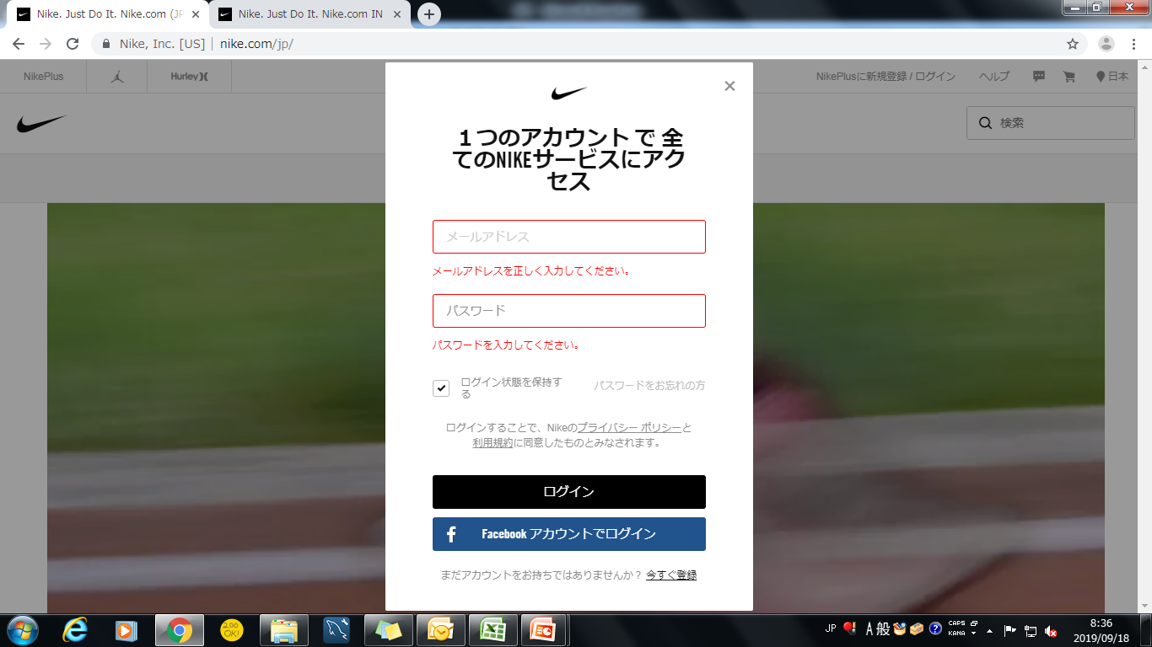
LOGIN PAGE ERROR MASSAGES
1
2

Slide 5
When click on login button it will show field level error please enter valid email address the font size is 12 and color of error massages is red
Please enter password also same red color massage with font size 12

Slide 6
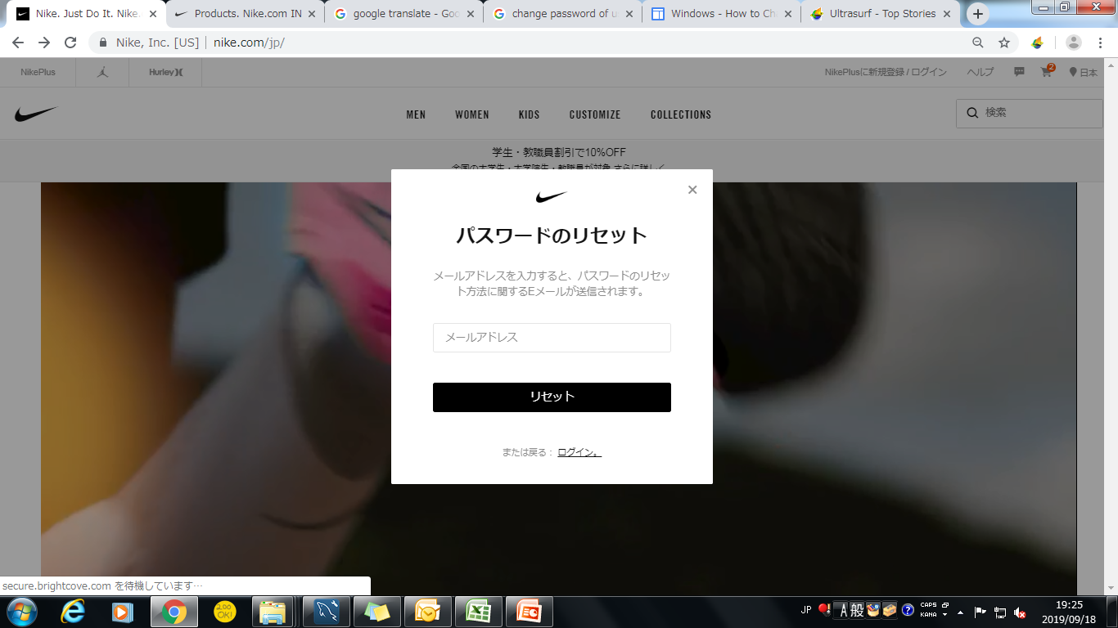
forgot password
5
1
2
3
4

Slide 7
New popup window with bold type heading reset password
Email address field is there to enter email id
With black background reset button is there to reset password
Small size of link is there to go back to the login page

Slide 8
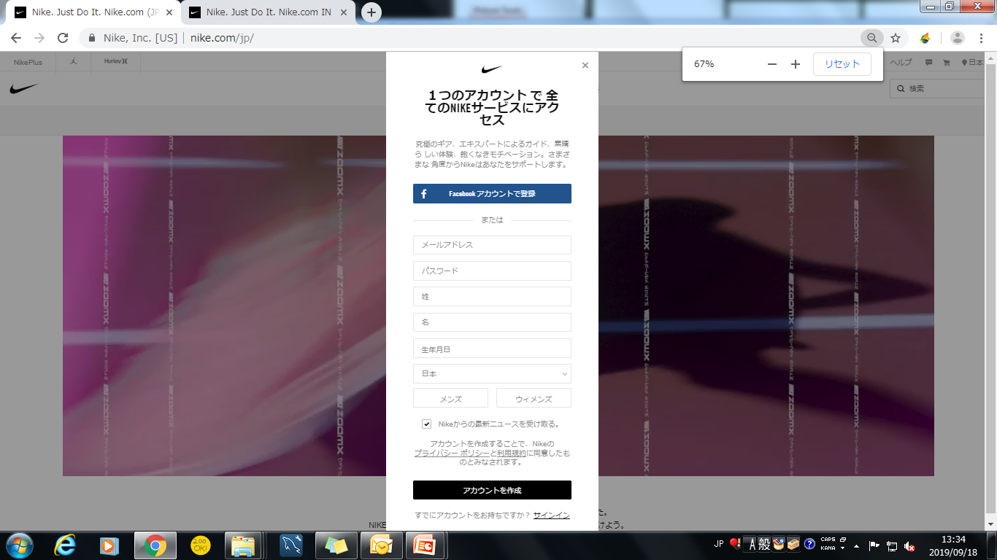
signup page
1
2
3
4
5
6
7

Slide 9
In that form blue button is there to create new user using face book account information
Simply divide two type of user creation so that’s why he used ‘or’ so the user can easily understand choose any one
fill all the fields properly it will take user main information like email address first name , last name, date of birth , and country
In gender selection they used two buttons male or female any one button click then change the border and icon in that button
this checkbox you click then all the latest offers are mail you
Create user button to create the user
One link is there to go sign in page

Slide 10
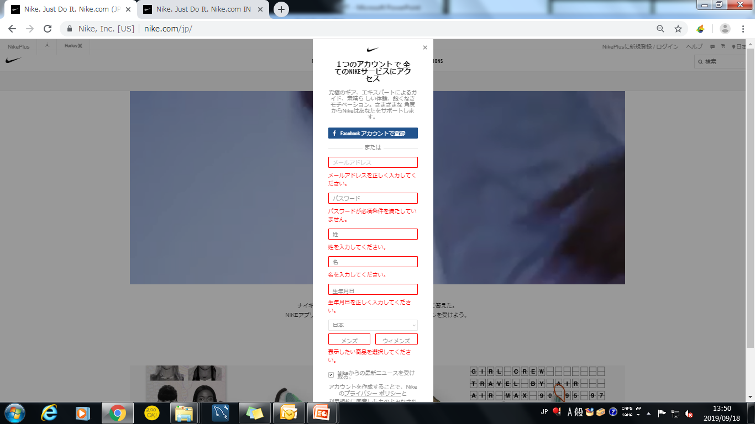
Signup error massages
1

Slide 11
Error messages all showing in small font size with red color and display in field level so user can easily identify what is wrong

Slide 12
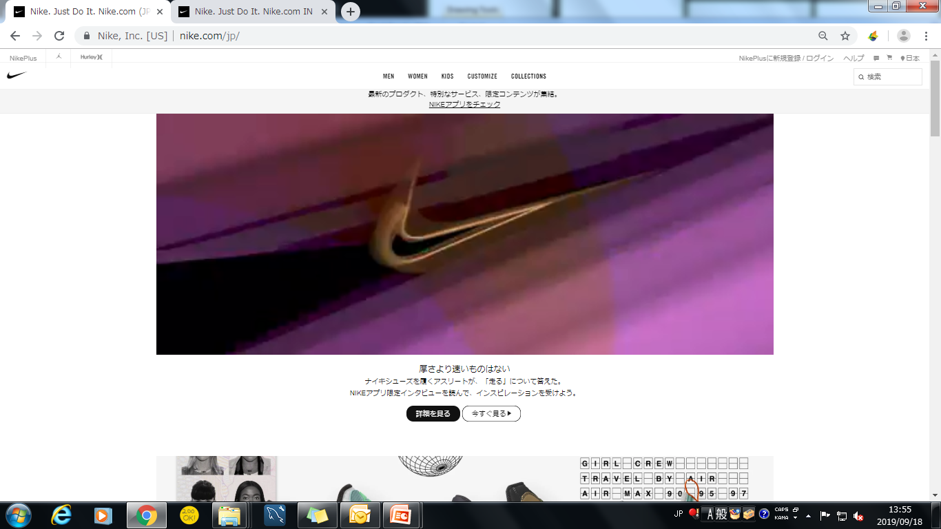
home screen
9
10
6
1
5
4
2
11
12
3
8
7

Slide 13
It is a small type horizontal slider in that slider new offer is showing and it will automatically move from right to left in 40 sec
In that icon showing your selected area or language you can change area or language simply click on that icon
Cart icon in that click you want to redirect cart page
Message icon in that message icon you can massage any query to the developer or admin
Help tag in that tag you want help then click that tag in that tag various menus present like order status, returns, contact us, view all , feedback , terms of policies etc
This tag is used to click sign or sign up form
video is playing continually to and showing Nike products
Small search box is present with small icon you want search anything from this site

Slide 14
All categories of menus present there this is top of the page with center align move cursor from this menu then display sub categories and menu get add black color underline
Nike logo is there in the top left corner
This is a special Nike brand icon move cursor in this icon the color will change to red in this icon
This is also special Nike brand icon

Slide 15
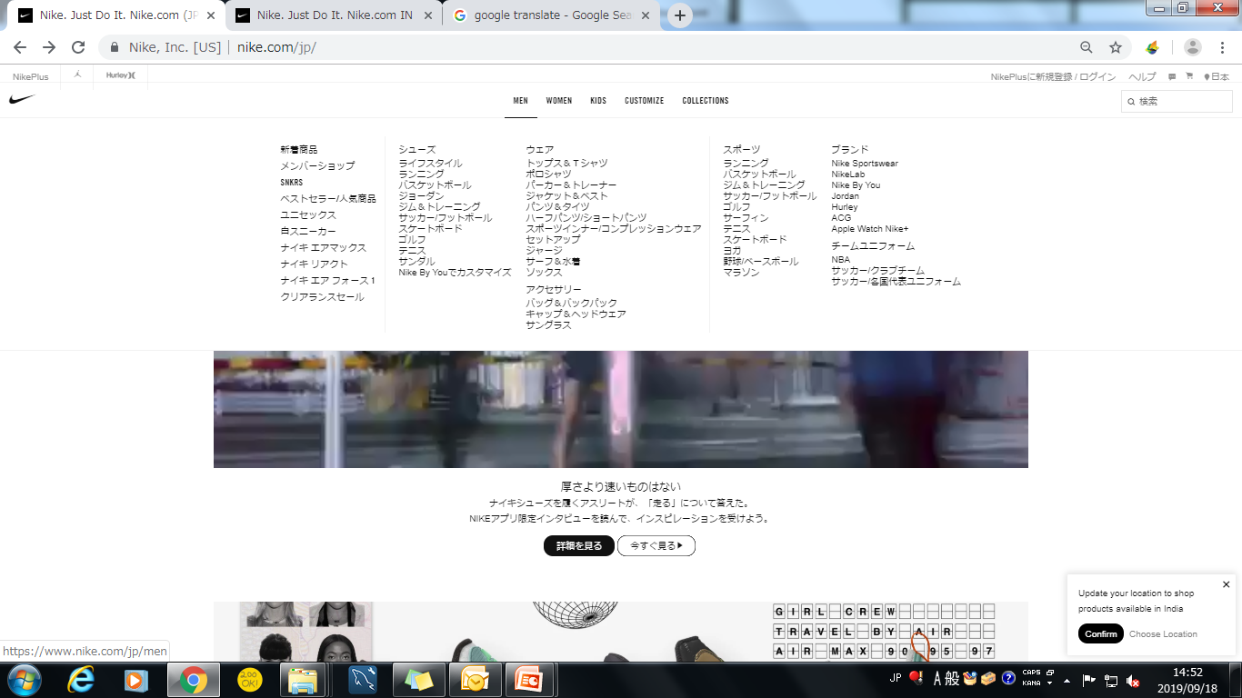
menu screen
2
1
3

Slide 16
Here the broad categories present In Nike like new release , sales , Nike lab etc
In this menus the product categories present like shoes , clothes, sport related products and all
In the sub categories of menus again that divided into various categories like running shoes, all shoes, basketball shoes etc.

Slide 17
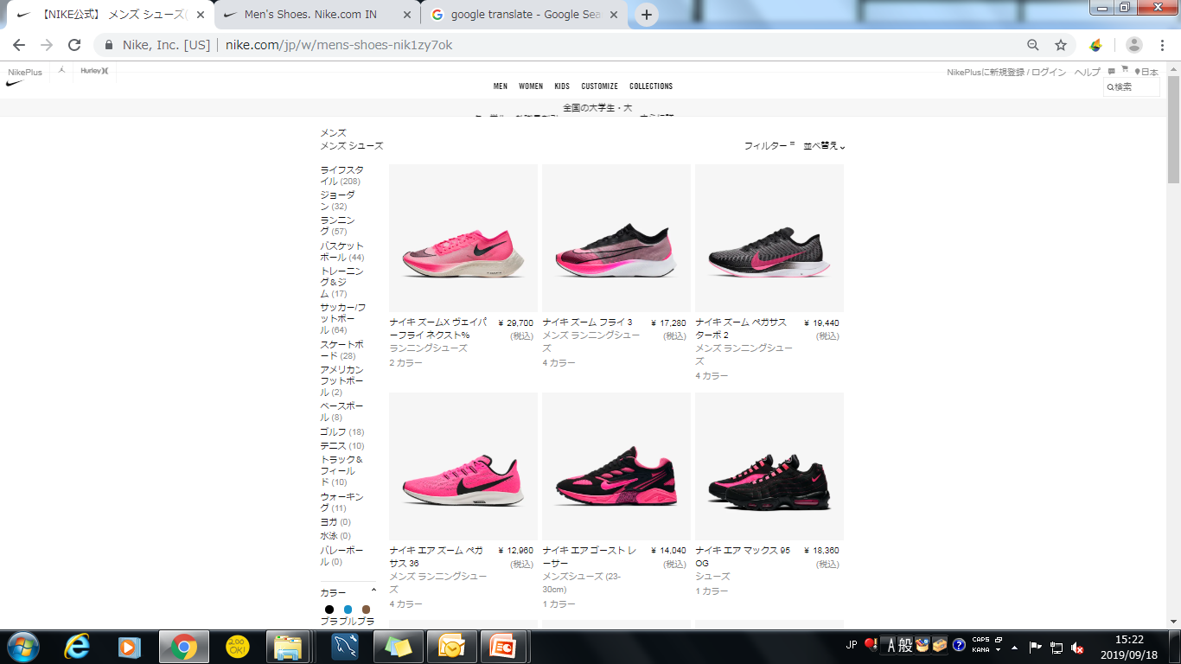
select menu
2
3
4
5
1
1
6
7

Slide 18
All product categories display in a small size vertical bar with black color and in a bracket display how many that category product in stock
Your selected categories display here with bold
Here the sort by menu bar is present to sort product featured wise and new product prices low to high and high to low
Your selected category products is displaying in a images
Product description and prize will display here all is clickable you want to click any image or description then display all information about that product
How many colors that product is present that number will display when move cursor from that then the label will change to various colors then move any color the product will change to that color
In that color s menus select any one color then show all product in thart color

Slide 19
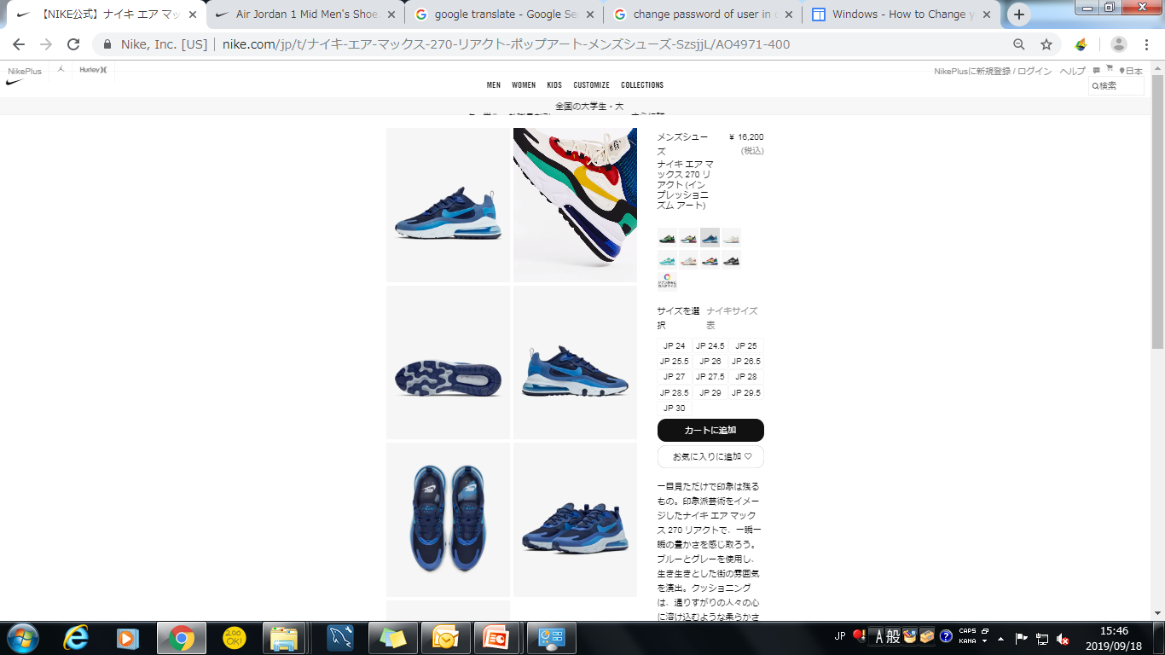
add to cart
2
3
4
8
1
5
6
7

Slide 20
All sites of product images is showing
One video will playing of that product
Prize and description is showing here
Various type of color product images is showing in small icon when you will move cursor from that icon then display massage this product is sold or not so it is very cool
Various type of size is showing here in number format
One black button is there that is add to cart in that click product will add to your cart
Product information and reviews are showing here anyone can see all the reviews of that product
Size guide option will used to display all sizes and guide you to what size you will get match

Slide 21
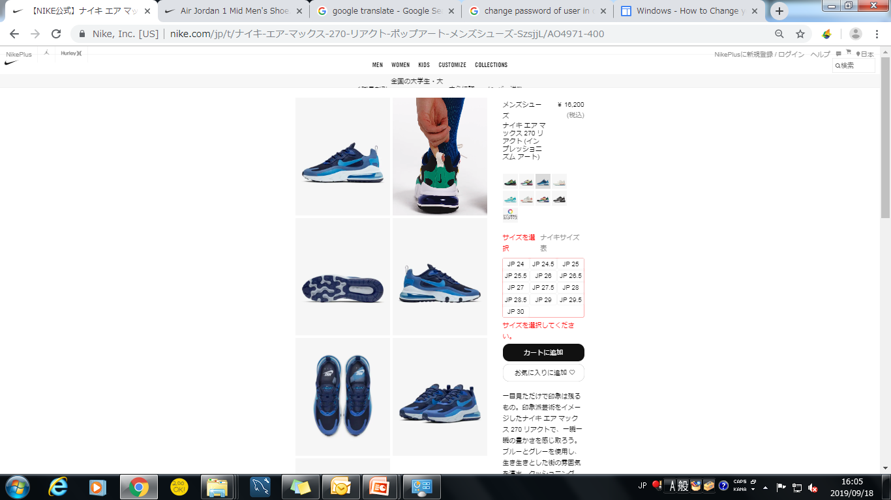
error massages add to cart
1
When click on add to cart button without selecting any color or size then display that error massages with red color and change header select size color to red

Slide 22
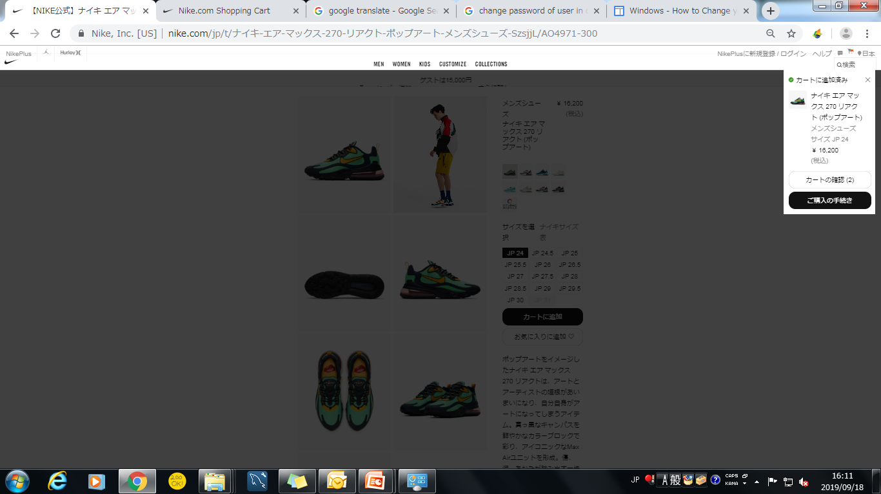
after Adding any product
5
1
2
3
4

Slide 23
Small popup will display in right corner of the page with product successfully added massage
Added product description display here with small size in black color and their prize with image of that product
View cart button have transparent background display in center of that popup
Checkout button are display in black background with white text color
The cart icon is now change to that type of icon means one product are successfully added to your cart
1

Slide 24
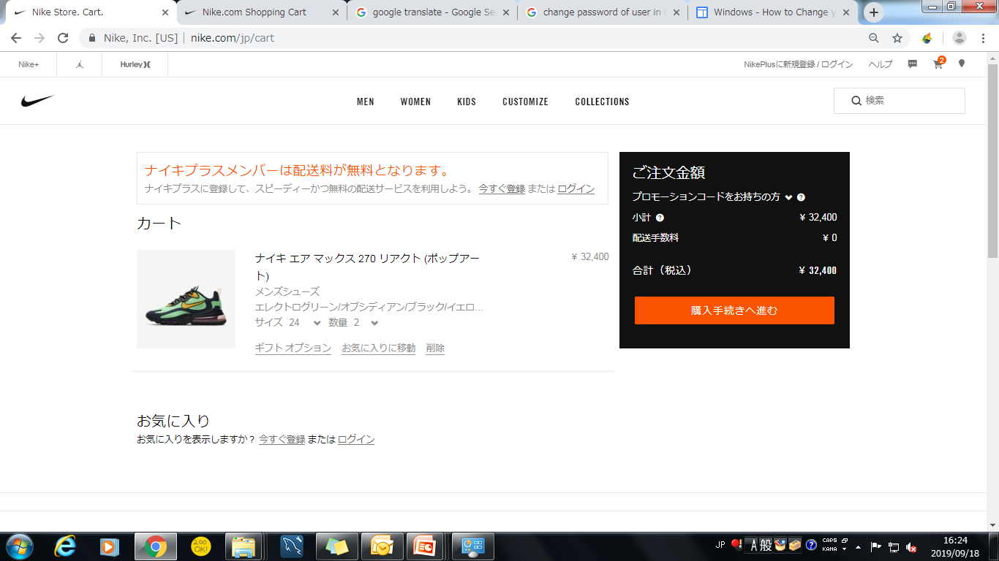
view cart
5
6
1
7
8
9
2
3
4

Slide 25
Full description of your product
Gift voucher link any voucher is present or not
Go to favorite link to check any your favorite product you want to add in cart or not
Remove link in this link you want remove your product from cart
Real prize of your product display small popup box
Any extra delivery charges or taxes showing here
Total prize are displaying here
Checkout button is display orange color that are match with black background popup

